Slide 1


AphA
Discover Your Professional Home in Health & Care Data and Analytics
Jane Johnston (LFEDIP)
Corielyn Bromley (AdvFEDIP)
www.aphanalysts.org
Notes:
Brief intro: who you are and AphA’s role nationally.
Frame: this is about supporting their work in primary care.

Slide 2
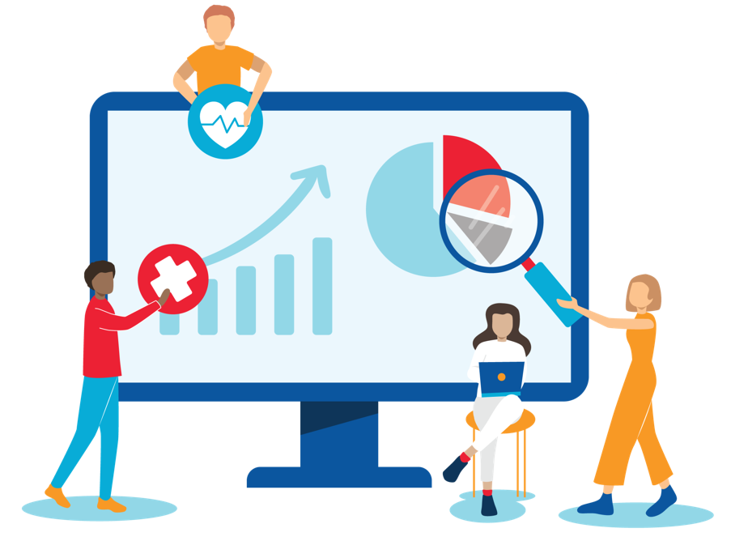
AphA Purpose
Our purpose is to raise the profile of and represent the voice of health and care data and analytics professionals as a recognised and respected industry expert, by providing a professional framework and an established support network.
We will help our members to drive up the quality and application of data and analytics to improve experience in a fast paced and dynamic health and care system.
www.aphanalysts.org

Slide 3






The AphA Journey
Started in the South West Region
First Conference at (Taunton)
Committee
Established
AphA CIC & Board
Established
New Board structure and constitution
First Strategy launched
2012
2013
2014
2016
2020
2025
www.aphanalysts.org

Slide 4


AphA – A Bit of Background
  Who AphA are
    A professional membership organisation supporting career progression and professional development
    A collective voice
    Nationally recognised for access to subject matter expertise
  Benefits of membership
    Stay informed
    Mentorship
    Exclusive content and training
    Networking and events
    Boost your career
    Professional accreditation
    Member recognition
    Special Interest Networks
“ The best investment you can make is in yourself ”
⁓ Warren Buffet ⁓
www.aphanalysts.org
Notes:
Our purpose is to raise the profile of and represent the voice of health and care data and analytics professionals as a recognised and respected industry expert, by providing a professional framework and an established support network.
We will help our members to drive up the quality and application of data and analytics to improve experience in a fast paced and dynamic health and care system.

Slide 5
The Changing NHS Landscape
Increasing demand across all services
Shift toward prevention and community care
Achieving value based healthcare
Strategic commissioning
Integrated Care Systems (ICSs)
Growing importance of data in decision-making
Data and Analytics is at the centre of this transformation
www.aphanalysts.org
Notes:
Reality:
Increasing workload
Shift to prevention, population health, neighbourhood working
Acknowledge pressure they are under.
Emphasise why these changes elevates their roles

Slide 6
Why Data & Analytics Matter More Than Ever
Informing clinical decisions
Managing population health
Reducing inequalities
Supporting service redesign
Data is no longer back-office — it’s frontline
www.aphanalysts.org
Notes:
Position:
Data and analytics are no longer a back-office function — they are central to clinical decision-making, service design, and system transformation.
Make it real: appointments, demand, risk, inequalities.
Position analytics as essential to daily decision-making.
Bridge to AphA:
That’s exactly where AphA exists — to support professionals like you to thrive in this changing landscape.

Slide 7
Where AphA Fits
Professional body for health and care data & analytics professionals
Supporting individuals, teams, and organisations
Aligning with NHS national direction
Helping analysts deliver impact, not just reports
www.aphanalysts.org
Notes:
AphA = professional home + practical support
Focus on impact, not just technical output.

Slide 8
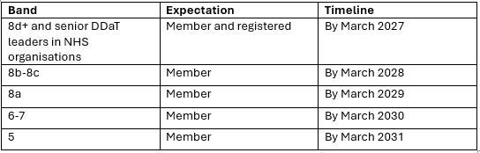
Aligning with NHS Direction
Future-proof your role and organisation
www.aphanalysts.org
Notes:
NHS England is introducing a progressive commitment to professional membership and registration for DDaT staff.
This approach brings DDaT in line with other established NHS professions and supports high-quality, safe delivery of digital services that underpin patient care.
*The senior DDaT leader in some NHS organisations is lower than 8d, the timeline expectation for membership should be considered as being March 2027.
There is national expectation that:
DDaT professionals join a professional body
Progress toward professional registration
AphA helps organisations meet this expectation
For individuals:
Future-proofs careers
Aligns with NHS workforce strategy
This is not optional long-term.
Positions them ahead of the curve.

Slide 9
Difference between a professional body and professional registration
A professional body is a membership organisation that supports a profession. Professional registration is the formal status awarded to an individual by that organisation.
Submit an application and evidence of competence
2
The professional body assesses your application
3
Join a professional body such as AphA
1
If successful you become professionally registered with FEDIP
4

Slide 10

Benefit 1 – Professional Identity
Recognition as part of a profession
Clear standards and expectations
Alignment with national workforce strategy
You are not ‘just the data person’
Notes:
Many data and analytics roles are:
Isolated
Multi-tasking across roles
Not formally recognised as “analysts”
AphA provides:
A recognised professional home
A shared identity across disciplines
Alignment with national standards and expectations
Many feel invisible or undervalued.
AphA provides recognition and legitimacy.
You’re not ‘just the data person’ — you’re part of a recognised profession.

Slide 11

Benefit 2 – Community and Networks
National and regional branches
Specialist networks (PHM, health economics, research)
Peer support across organisations
Solve problems together, not alone
Notes:
AphA offers:
National and regional branches
Specialist networks:
Population health
Health economics
Research
Clinical Coding Leaders
Chief Data & Analytics Officer network
Communities of practice
Translate to your world:
Learn how your AphA community are using data
Share solutions for:
Demand management
Long-term condition management
Inequalities
AphA connects member to peers solving similar issues.
You don’t have to solve the same problems in isolation — someone in AphA has already tackled it.

Slide 12
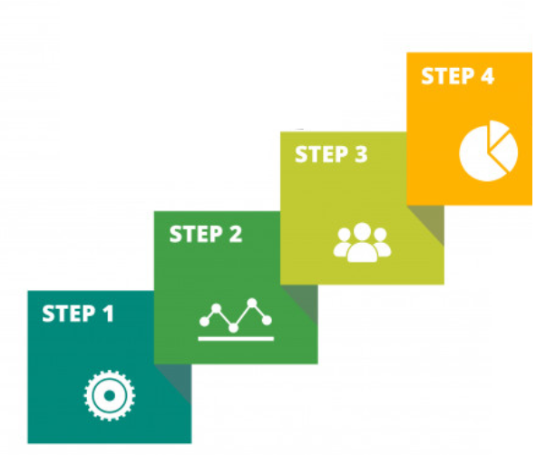
Benefit 3 – Skills and Career Development
Competency frameworks
Training and events
Mentorship opportunities
Knowledge hub
Turn capability into a career
Notes:
Data and analytics roles are often:
Broad but not structured
Limited access to formal development
AphA provides:
Competency frameworks
Training & events
Knowledge hub
Mentorship opportunities
Why this matters:
Helps staff move from:
Reporting → Insight → Impact
Supports career pathways that often don’t exist locally
Many roles lack structure or progression.
AphA helps build clear career pathways.
AphA helps turn capability into a career.

Slide 13

Benefit 4 – Better Patient Outcomes
Better data → better decisions
Better insight → better targeting
Better analytics → reduced inequalities
This is about better care, not just data
Notes:
Tie everything back to patient outcomes:
Better data → better decisions
Better insight → better targeting
Better analytics → reduced inequalities
Examples relevant to primary care:
Risk stratification
Population health management
Medicines optimisation
Prevention and early intervention
Always link back to patient benefit.
Use examples: risk stratification, prevention.
This isn’t about data for data’s sake — it’s about better care for your patients.

Slide 14
What is Professional Registration? And AphA’s role
Through FEDIP
Recognised UK-wide standard
Guidance and support
Frameworks and resources
Community of peers
Like a chartered status for data and analytical professionals
You are supported throughout the journey
www.aphanalysts.org
Notes:
What is Professional Registration?
Through FEDIP (Federation for Informatics Professionals)
Recognised standard across UK health informatics
It’s the equivalent of chartered status for data and analytics professionals. RCN/NMC example?
AphA’s Role
AphA supports members on the journey to registration
Provides:
Frameworks
Guidance
Community support
Keep simple and jargon-free.
Analogy to clinical/professional registration helps. – RCN/NMC
Remove fear/complexity.
AphA makes the process achievable.
You don’t have to navigate professionalisation alone — AphA walks that journey with you

Slide 15
Why Become Registered?
Demonstrate your skills, competencies and commitment at any stage of your career
Validation of your knowledge, skills and abilities regardless of academic history
An independent indication of competency and credibility
It’s your career and development
Soon to become a requirement
Build personal credibility and organisational confidence
www.aphanalysts.org
Notes:
Why it matters
For individuals:
Recognition of expertise
Credibility with clinicians and leaders
Career progression
Mobility across organisations
For organisations:
Assurance of capability
Consistency of standards
Supports governance and trust
Balance personal and organisational benefits.
Emphasise credibility with clinicians.

Slide 16


What you need to do next…..
Join AphA
Choose your FEDIP level
Apply via the FEDIP website

Slide 17
Which Level
Practitioner | Senior Practitioner | Advanced Practitioner | Leading Practitioner
Exercises autonomy subject to overall guidance and direction. Performs a range of work, sometimes complex and nonroutine. Selects and uses relevant methods and procedures. Demonstrates an analytical and systematic approach to issue resolution. | Exercises autonomy within limited parameters. May have responsibility for the work of others. Performs a range of work, often complex nonroutine technical/professional activities. Identifies, selects and uses appropriate standards, methods, tools and applications. | Exercise autonomy within broad but well-defined parameters. Builds appropriate and effective business relationships. Performs a range of complex technical / professional work. Applies fundamental principles in meeting work requirements. Advises on available standards, methods, tools and applications relevant to own specialism, making appropriate choices from alternatives. | Exercise autonomy within broad parameters. Has authority over all aspects of a significant area of work. Formulation and application of policy. Formulation and implementation of strategy. Address complex, non- routine organisational problems. Has a full range of strategic leadership and management skills. Has an in depth understanding of the industry and implications of emerging technologies on the wider business environment.

Slide 18
What is needed to apply….
Application Form
3 Reflective Practices
Evidence

Slide 19
Reflective Practice Model
Use the STAR approach for reflective practice
  Situation
  Tasks
  Actions
  Results
Map to the core professional standards
Map to the healthcare contextual standards
S
T
A
R
P1 – Applying Methods
P2 – Using Methods to Solve Problems
P3 – Organisation & Planning
P4 – Autonomous Practice
P5 – Accountability & Responsibility
P6 – Communication
P7 – Collaborative Working
P8 – Demonstrating Professionalism
P9 – Continued Professional Development
Situation
Tasks
Actions
Results
Explain the situation and context
What was the problem or challenge and how would you overcome
What did you do and what did it take
What was the outcome
C1 – Impact on Healthcare
C2 – Awareness of Sectors
C3 – Terminology
C4 – Healthcare Informatics
C5 – Information Governance
C6 – GDPR

Slide 20
Overview of Standards
Standard | Professional Competencies | Guidance
SP1 – Applying methods | Undertake health and care data and/or analytics tasks relevant to specialism identifying, selecting and employing appropriate methods, tools and procedures | Describe a situation in which you have undertaken health and care data and/or analytics tasks within your own specialism under your own direction. What was it you actually did? How did you choose the most appropriate methods What happened as a result of your work/how successful were you?
SP2 – Using Methods to Solve Problems | Apply appropriate methods to identify and address complex problems | Describe a situation where you have needed to apply a specific method? What problems required them and why? How did you apply these methods? What were the results of your actions?
SP3 Organisation & Planning | Identify, organise and use resources to complete tasks or deliver services efficiently and effectively with due regard to safety, security and quality. | Describe the service or task that needed to be delivered efficiently by you. How did you identify the resources available to you and how did you organise them? How did you ensure efficiency whilst managing safety, security, and quality? What were the results of your actions?
SP4 Autonomous Practice | Work reliably and effectively without supervision, where appropriate supervising the work of others, and adheres to appropriate guidance and good practice | Describe the context in which you worked without supervision. To what extent did you supervise others? What codes of practice did you follow? How did you ensure effectiveness and reliability? What were the outcomes of this work?
SP5 Accountability & Responsibility | Accept responsibility for work of self and others (where appropriate) | Describe what work you are responsible for, including the work of others where appropriate and their roles How did this work get allocated? How did you take responsibility for it? (e.g. feedback, follow-up, outcomes etc.) What have been your successes?

Slide 21
Overview of Standards
Standard | Professional Competencies | Guidance
SP6 Communication | Use oral, written and electronic communication methods for communicating effectively. Use terminology appropriate to the health and care sector | Describe the situations in which you needed to use different methods of communication How did you use these methods to be most effective? How did you employ appropriate terminology? What were the outcomes of these means of communication / how well did they work
SP7 Collaborative Working | Works effectively with colleagues, clients, suppliers and/or the public, being aware of needs and concerns of others, particularly related to diversity and equality | Describe the situations in which you needed to work with different people. What were the challenges in working with these groups? What actions did you take to work effectively with these groups? What were the outcomes of these interactions with specific reference to needs, especially diversity and equality? How have these interactions improved as a senior member of the team?
SP8 Demonstrating Professionalism | Comply with the AphA Code of Conduct | Consider AphA’s Code of Conduct Describe the situations in which compliance with them applies to your role How have you ensured compliance with the code of conduct? What have been the results of compliance?
SP9 Continued Professional Development | Carry out and record Continued Professional Development (CPD) necessary to maintain and improve competence in your own area of practice | Describe recent and relevant CPD for your role. What is the overall objective of your CPD? What areas have you developed? How did you achieve and record this? How has your development impacted the success of your work?

Slide 22
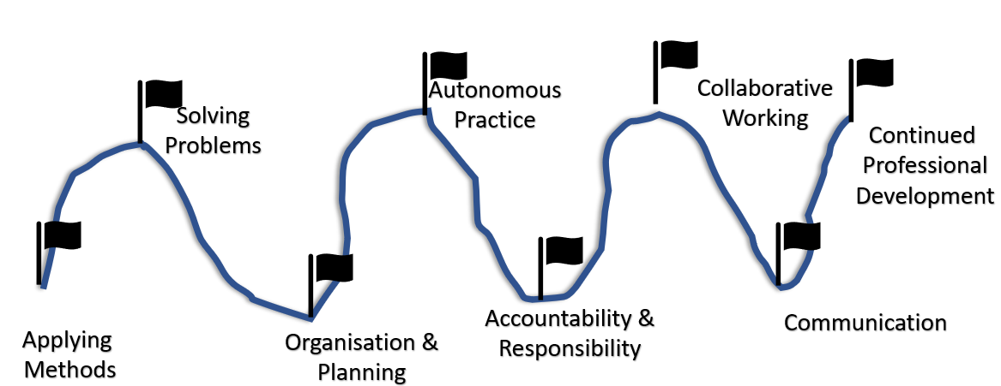

Overview of Contextual Standards
C1 – Impact on Healthcare
C2 – Awareness of Sectors
C3 – Terminology
C4 – Healthcare Informatics
C5 – Information Governance
C6 – GDPR
Describe Your Journey
(Through the Standards!)

Slide 23
How long does it take? (and other advice)
Dedicate a weekend, annual leave or evenings
Approach your reflective practices by thinking of a “chunky” piece of work you’ve done
Additional reflective practices to cover missing standards
Reflective practices are like telling a story, walk the assessor through your thinking
If moved jobs and want to use past example make sure you can evidence it
There’s no hard time limit, but to ensure CPD is evident, examples should be ‘recent’
Make sure you have evidenced the standards not just reflective practice points
This is your registration not your current job or employer’s

Slide 24
Application Windows and Workshops
Window open every quarter (April, July, October, January)
Introduction workshop held 1 month before window opens – our next one is 16th September @1pm.
Q&A workshop 2 weeks before window closes – our next one is 15th October @1pm
It’s a supportive process
www.aphanalysts.org

Slide 25

Questions?
www.aphanalysts.org
Notes:
What are your biggest data challenges?
What support would make the biggest difference?
How can AphA help you?

