Slide 1
Strategic Commissioning Development Programme

Slide 2
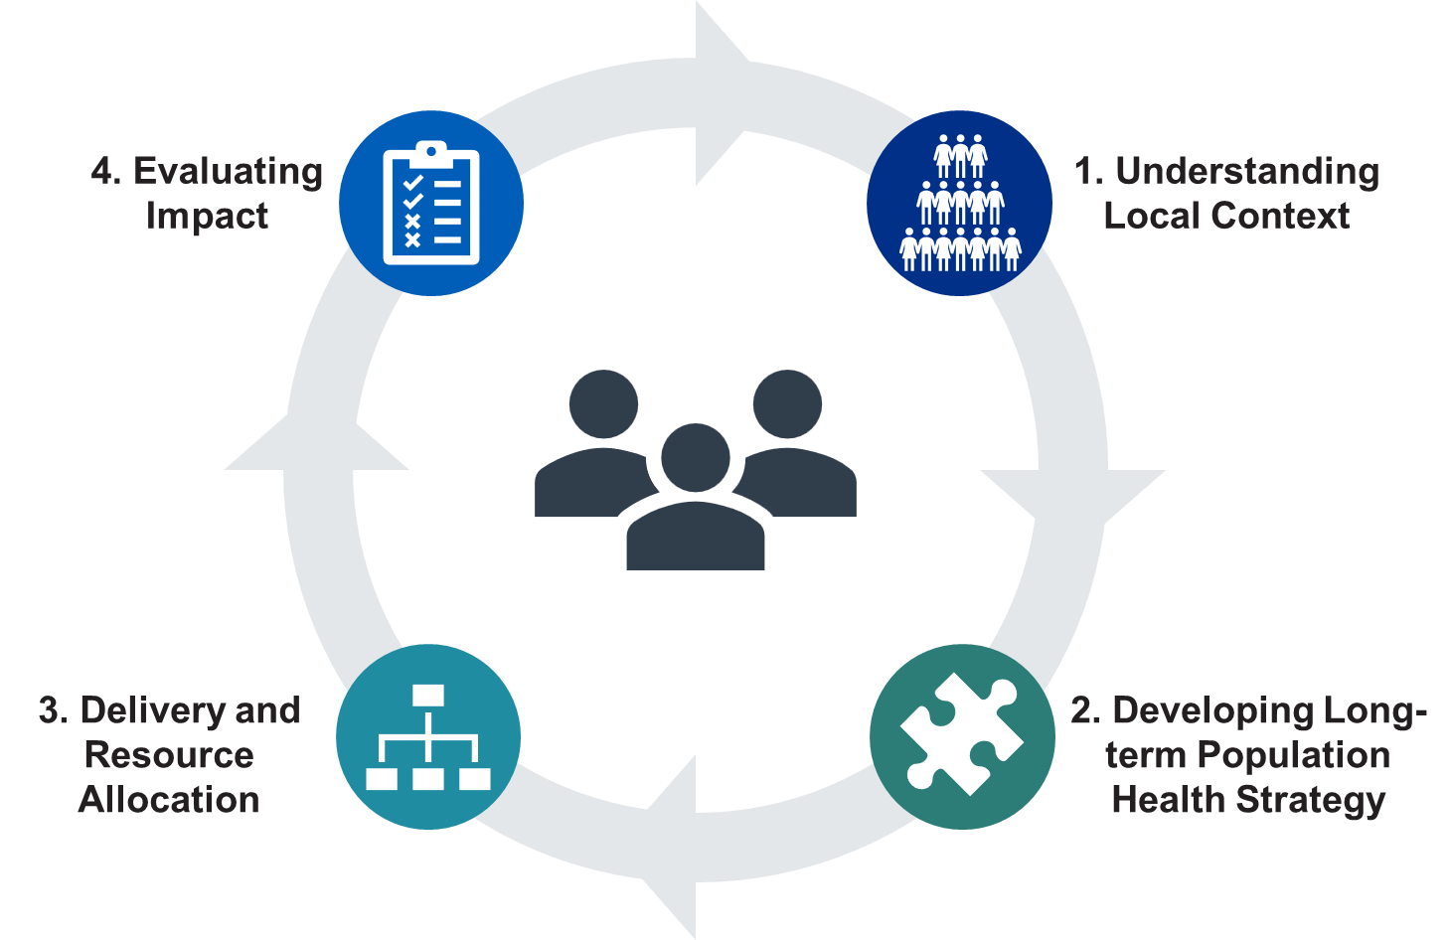
What is Strategic Commissioning?
The Strategic Commissioning Cycle
Strategic commissioning is the continuous, evidence-based process through which ICBs plan, purchase, monitor and evaluate services to improve population health, tackle inequalities and secure equitable access to high-quality care.
It requires using public resources to create the greatest value for local populations, in line with the NHS Constitution and with a clear focus on long-term outcomes.
ICBs act as strategic commissioners on behalf of their populations, working with local government and partners to address the wider determinants of health and support wider socioeconomic development.
Strategic commissioning is central to the NHS’s shift from sickness to prevention, hospital to community, and analogue to digital - improving both allocative efficiency (ensuring resources flow to the most effective mix of activities) and technical efficiency (supporting providers to deliver care more productively).
The process is organised into four interconnected stages:
Understanding local context: Develop a deep, data-driven picture of the population: needs, risks, inequalities, demand drivers, quality of existing provision and system performance, using joined-up person-level data, insight from partners and feedback from communities.
Developing long-term population health strategy: Use this insight to set long-term priorities, redesign pathways and develop evidence-based population health improvement plans, aligned with national guidance and modern service frameworks.
Delivery and resource allocation: Allocate resources, contract for services, shape the provider market and manage performance over the longer term to deliver the strategic outcomes set out in the ICB strategy and population health plan.
Evaluating impact: Assess the outcomes and value of commissioned services and interventions, drawing on utilisation data, clinical markers, patient and staff experience, and wider intelligence to learn, improve and inform future decisions.
Notes:
Plain slide with subhead and bullets

Slide 3
What is the Strategic Commissioning Development Programme?
The Strategic Commissioning Development Programme is the national support offer to turn strategic commissioning policy into practice.
It helps ICBs build the capability, confidence and infrastructure to commission differently: using population health insight, stronger governance, and new contractual and payment models to scale neighbourhood health, improve access and drive better outcomes.
Capability & Learning
Leadership & Decision-Making
Applied Commissioning
Intelligence, Outcomes & Evaluation
Policy, Partnerships & Service Models
  Open to all commissioning colleagues. Centred around the Commissioning Academy, this is a national, always-on offer anchored by a capability diagnostic, helping ICBs identify where to focus investment.
  Targeted development for ICB boards and senior leaders, building confidence to make evidence-led decisions and lead neighbourhood health transformation.
  An 18-month action learning programme where ICB teams commission a real neighbourhood health model for a defined population cohort, supported through each phase of the commissioning cycle.
  Developing the analytical infrastructure ICBs need to commission on evidence. Delivered through the Commissioning Intelligence Centre.
  Supporting ICBs to understand and apply emerging national policy, including Modern Service Frameworks and new provider models (IHOs, MNPs, SNPs), in their local commissioning and contracting.
  What's on offer: diagnostic toolkit (8 functional areas); e-learning and knowledge hub on NHS Futures; Applied Commissioning Guides; podcasts and communities of practice.
  What's on offer: Board development programme; Neighbourhood Health Learning Networks (with NHS Alliance and The King's Fund); decision quality support (Strategy Unit).
  What's on offer: Six structured phases from population insight to evaluation; analytical and commercial support embedded throughout; three staggered waves enabling peer learning across cohorts.
  What's on offer: Intelligence function assessment and individual development roadmaps; analytical skills training; FDP Strategic Commissioning Tool support; Neighbourhood Health Index (from September 2026).
  What's on offer: Modern Service Framework orientation materials; local government and VCSE partnership offer; IHO/MNP/SNP commissioning support; joint-commissioning case studies.
  Outcome: A consistent commissioning baseline across all ICBs, with practical tools and learning applicable immediately.
  Outcome: Boards and senior leaders able to make robust, evidence-led decisions with clearer governance, grip on trade-offs and confident challenge.
  Outcome: Neighbourhood health commissioning models designed and implemented locally, with measurable improvements in access, quality and outcomes.
  Outcome: Faster, higher-quality commissioning decisions powered by accessible analytics, reducing variation and strengthening the evidence base for change.
  Outcome: Specific programme offers are being co-designed with ICBs and will be confirmed as the IHO model and Modern Service Frameworks develop.

Slide 4
What’s on offer
From 10 June 2026 you can start straight away:
Register for The Commissioning Academy
Your go-to space for strategic commissioning.
Bringing together high‑quality learning, practical tools and real‑world insight in one place. This platform supports commissioners at every level to build the confidence, capability and behaviours needed to improve population health and embed value‑based care.
Start here, connect with peers, build capability that lasts.
Universal Support to Professionalise Commissioning
Start your strategic commissioning journey with the Capability Self‑Assessment toolkit:
Enrol on the “Introduction to Strategic Commissioning” e‑module:
Join the Strategic Commissioning Learning Forum:
Get free access to the Faculty for Value‑Based Care led by Sir Muir Gray:
Use the diagnostic to understand strengths and gaps with your team and be signposted to practical resources and further learning via the Commissioning.
An introductory e-module for commissioners, providing a basic understanding of the practicalities and core activities of strategic commissioning.
Hear from experts, connect with peers, and share learning grounded in real commissioning challenges.
Including free access to an introductory value‑based care e‑module and supporting resources.

Slide 5
Commissioning Intelligence Centre
The Commissioning Intelligence Centre is a national support offer that helps ICBs make better, faster commissioning decisions by bringing together data, evidence and specialist expertise that systems may not be able to sustain on their own.
FDP Strategic Commissioning Tool
Deploy and implement population health modules
Enable segmentation, cost and utilisation analytics
Impact: consistent metrics and faster, evidence-led pathway and investment decisions
Health economics and actuarial support
Cost effectiveness and ROI modelling
Demand and utilisation forecasting
Impact: clearer value for money and financial risk before commitments are made
ICB Intelligence Function Network
Shared analytical models and methods
Reproducible pipelines and best practice
Impact: higher quality, comparable insights and reduced duplication across ICBs
Evidence, evaluation and advisory support
Evidence reviews and synthesis
Evaluation and impact assessment
Impact: confident prioritisation and stronger decisions on redesign or disinvestment

Slide 6
What’s on offer
What’s coming next (from Autumn 2026)
Universal Support to Professionalise Commissioning
Wider action learning and implementation support : a 12-month programme for every system - Commissioning in Practice: action learning to catalyse neighbourhood and IHO contracts
Further e-learning modules: taking you through each stage of strategic commissioning
Strategic commissioning learning forum: hear from experts, connect with peers, and share learning grounded in real commissioning challenges. These session will take place monthly covering topics such as; how we embed value-based care at scale, to building an intelligence function, what we really mean by the payer function and how to set it up
Neighbourhood learning networks: to support practical commissioning for neighbourhood health models.
Commissioning intelligence centre: national support offer helping ICBS make better, faster commissioning decisions by bringing together evidence, analytics and specialist expertise.

